Slide 1

SENTIMENT ANALYSIS ON IMDB MOVIE REVIEWS
Sanjana Rayarala- A20548132
Sai Dheeraj Surampally- A20545700
Rahul Narahari- A20545662

Slide 2
INTRODUCTION
Sentiment analysis, a burgeoning field within natural language processing, plays a pivotal role in deciphering and categorizing subjective information from textual data
In an era dominated by digital content, understanding public sentiment expressed in reviews, comments, and social media has become increasingly essential.
This project focuses on sentiment analysis within the context of IMDB movie reviews, utilizing the powerful capabilities of the R programming language and various libraries.
By delving into the rich IMDB dataset, the project aims to not only categorize sentiments but also explore the intricacies of textual patterns that distinguish positive and negative sentiments in the realm of movie critiques.

Slide 3
PROBLEM STATEMENT
The project addresses the challenge of effectively analyzing and interpreting the vast and growing volume of textual movie reviews on platforms like IMDb. In the realm of digital content where user-generated reviews significantly influence public perception and decision-making, there is a critical need for an automated system that can accurately classify these reviews into relevant sentiment categories. This task involves dealing with the complexities of natural language, which includes understanding context, nuances, and varied expressions of human emotions in text. The goal is to develop a robust sentiment analysis application that can process large datasets of movie reviews, categorizing them into 'positive' or 'negative' sentiments. The final aim is to deploy this model as an accessible API, providing a practical tool for filmmakers, marketers, recommendation systems, and movie enthusiasts to gauge public sentiment.

Slide 4
PROPOSED METHODOLOGY
The proposed methodology for the sentiment analysis project on IMDb movie reviews encompasses several key stages, from data acquisition to model deployment. Here is a detailed approach:
Data Gathering
Data Preparation
Data Cleaning
Exploratory Data Analysis (EDA)
Feature Extraction
Model Development and Training
Model evaluation
API Development and Deployment

Slide 5
DATA GATHERING
Dataset Source: IMDB 50K Movie Reviews Dataset, Kaggle (IMDB Dataset of 50K Movie Reviews (kaggle.com))
Variables include "review" for textual content and "sentiment" for sentiment labels.
The dataset comprises a total of 49,528 unique entries(reviews), each described by 2 attributes(sentiment).

Slide 6
Data Preparation Steps
Importing the data.
Description of data.
Checking missed values / duplicate entries.
Check if data is biased.

Slide 7
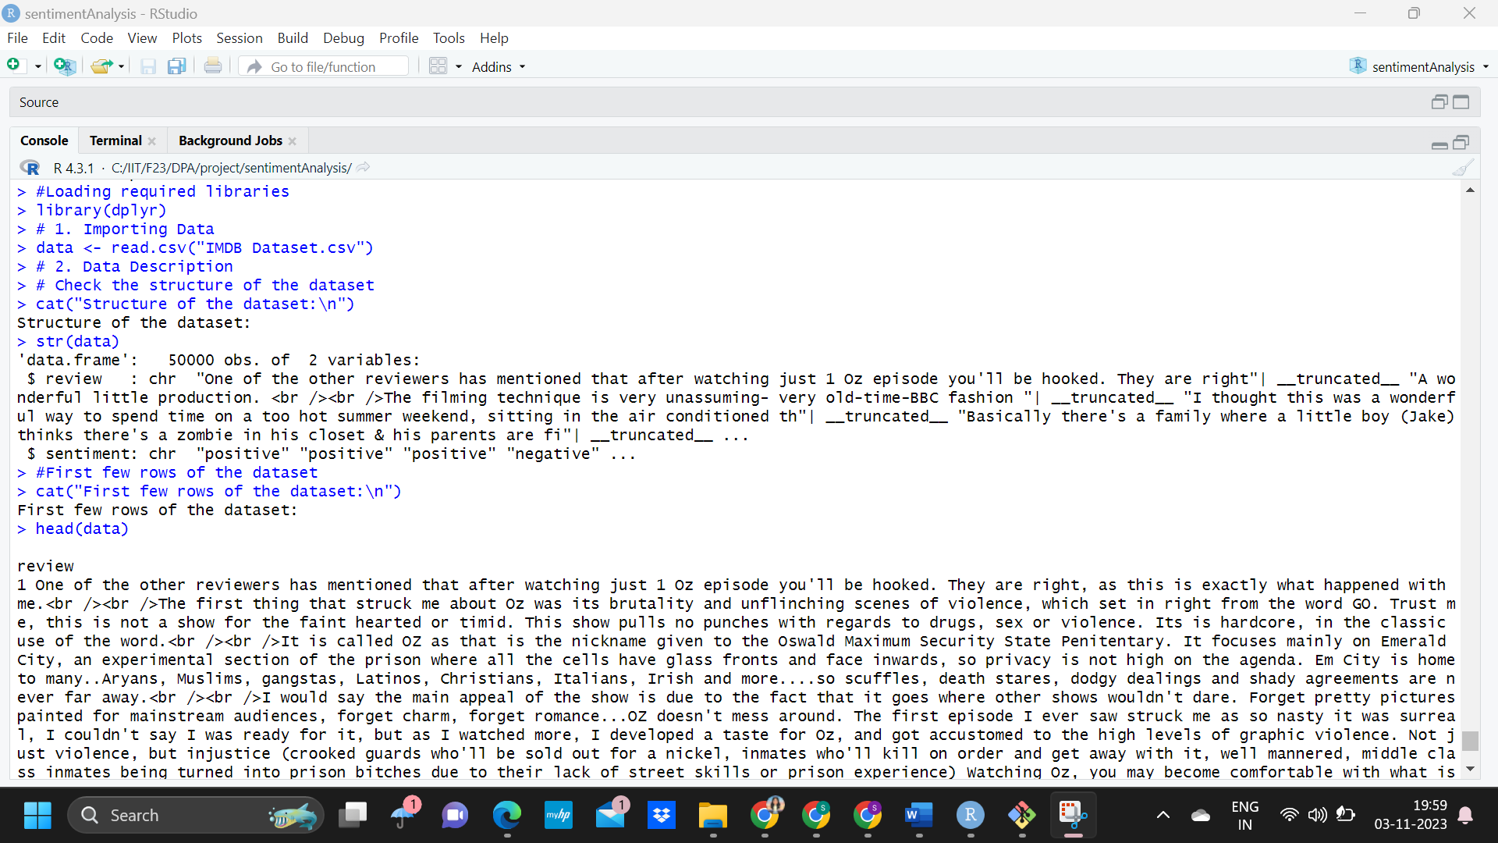
IMPORTING THE DATA

Slide 8
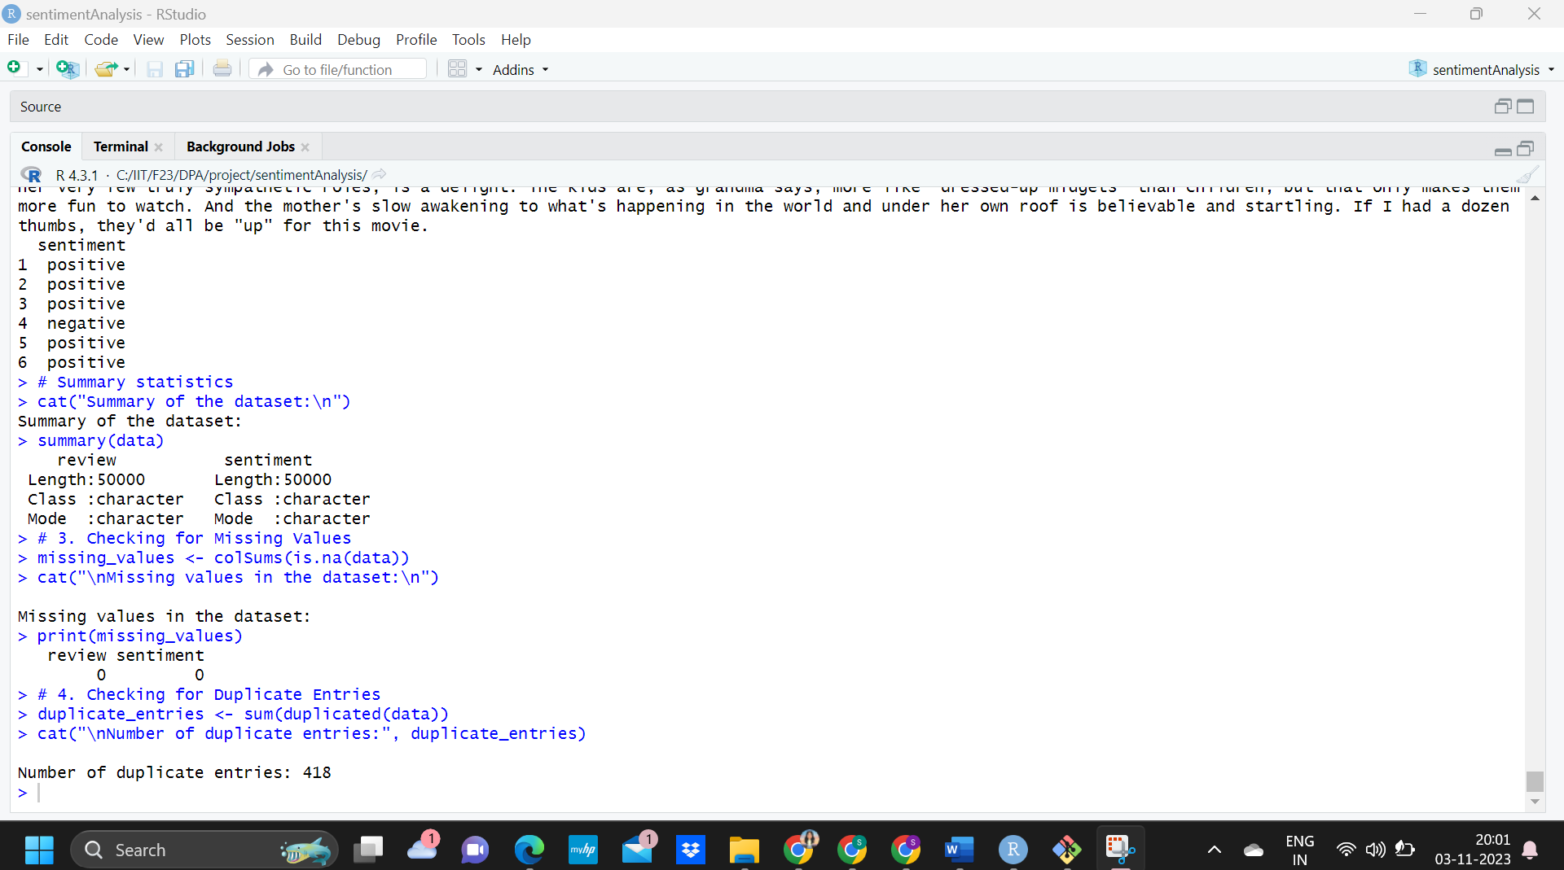
SUMMARY OF THE DTASETS
DESCRIPTION OF THE DATA

Slide 9
DUPLICATE ENTRIES AND REVIEWS
CHECKING MISSING/DUPLICATE ENTRIES
SUMMARY OF THE DTASETS
SUMMARY OF THE DTASETS
Missing values: 0
Duplicate entries: 418

Slide 10
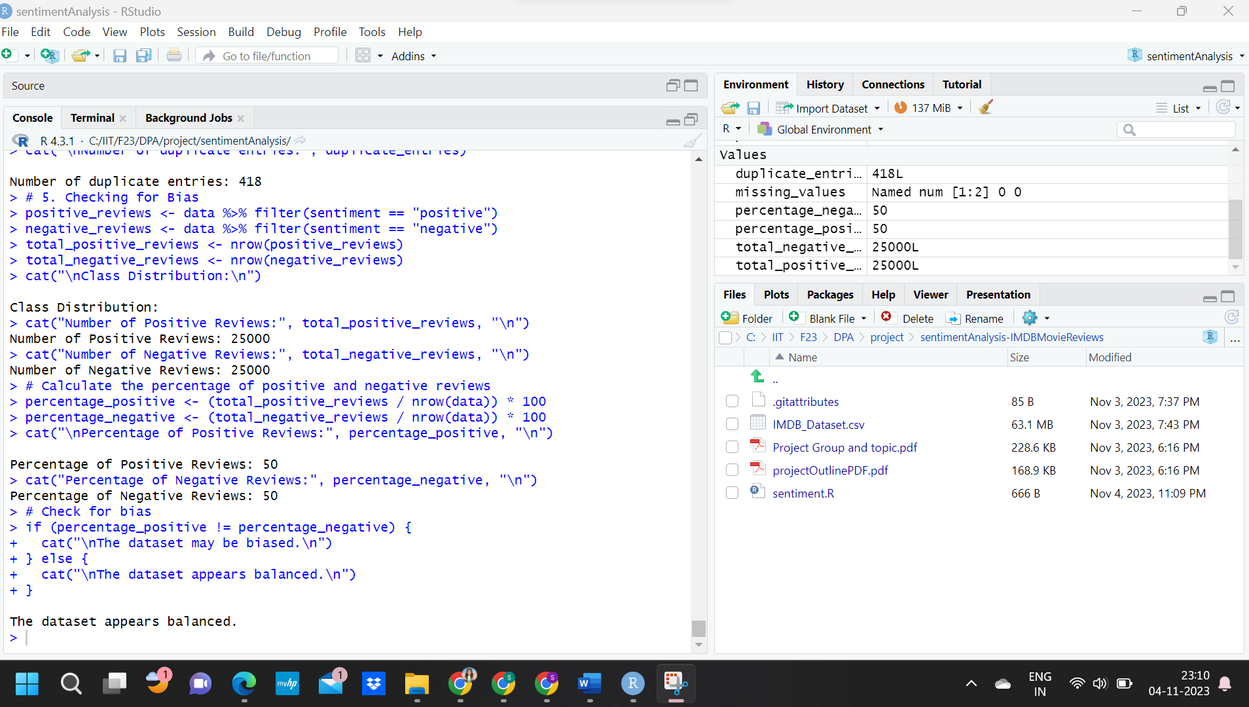
DUPLICATE ENTRIES AND REVIEWS
CHECKING IF DATASET IS BIASED
SUMMARY OF THE DTASETS
SUMMARY OF THE DTASETS

Slide 11
DATA CLEANING
Handling missing/duplicate values
Convert text to lower case
Removing special characters and numbers
Removing Punctuation
Removing stopwords

Slide 12
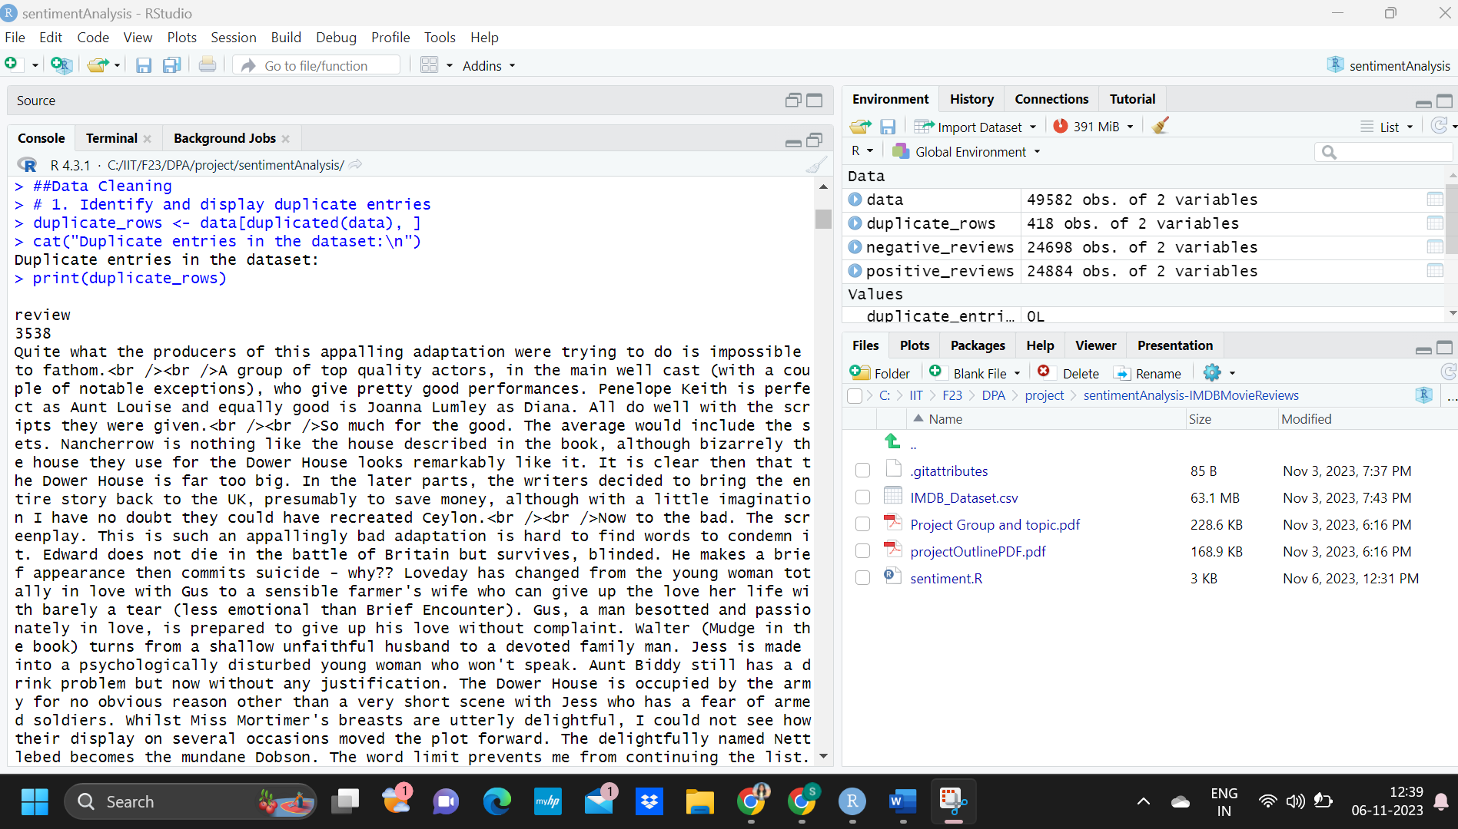
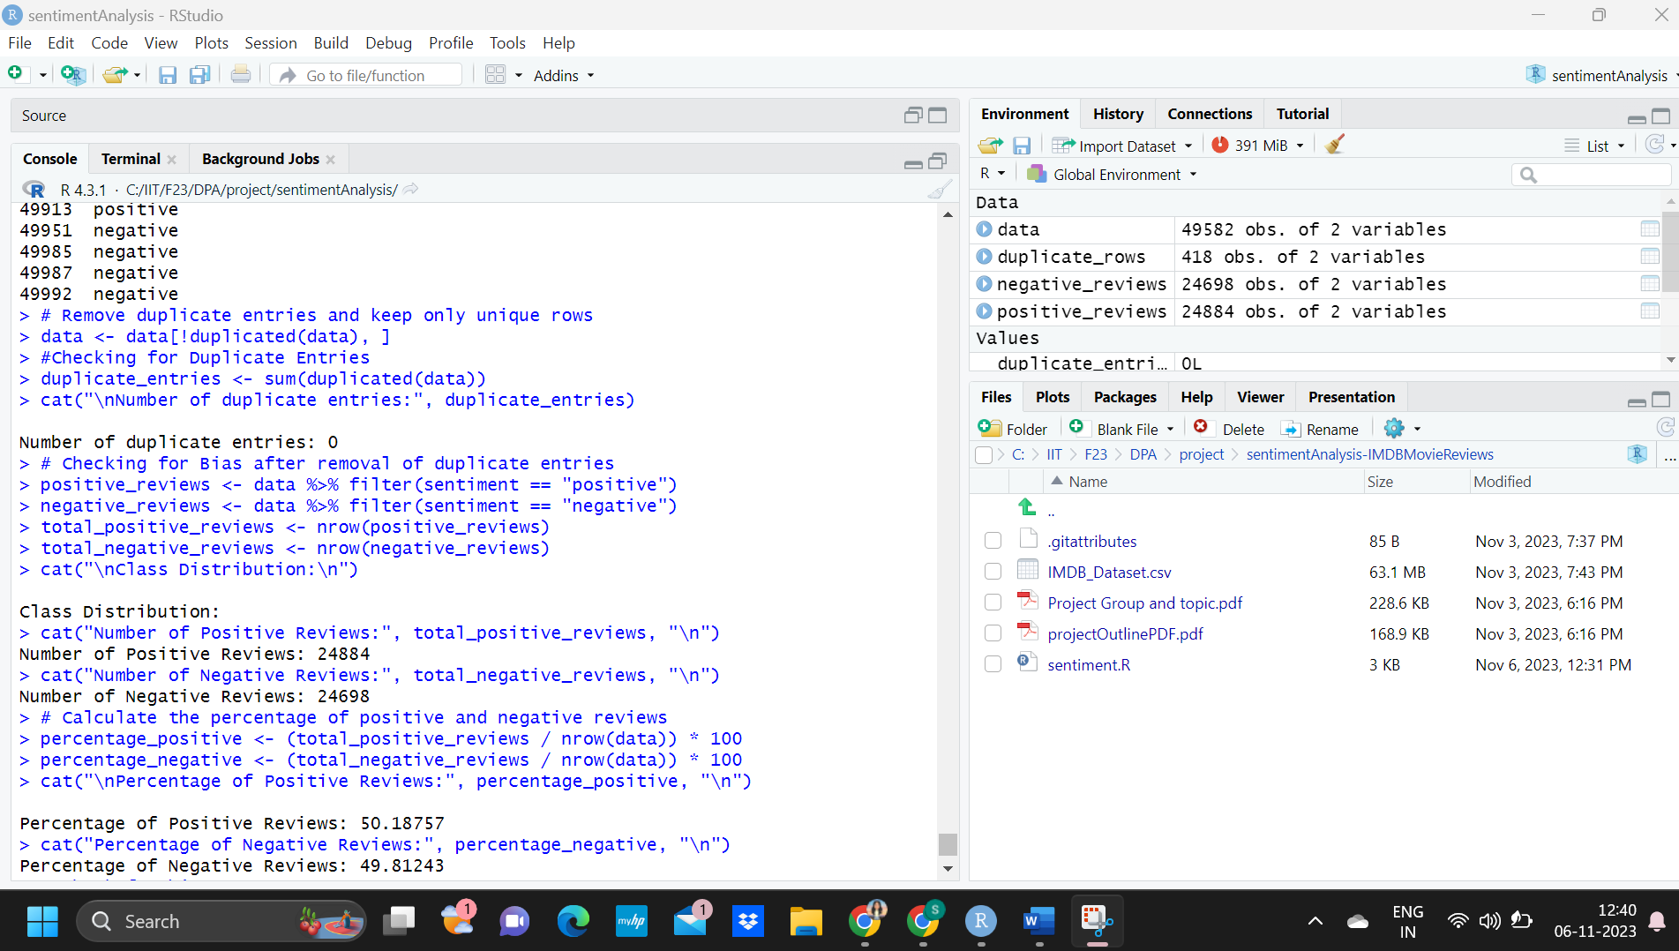
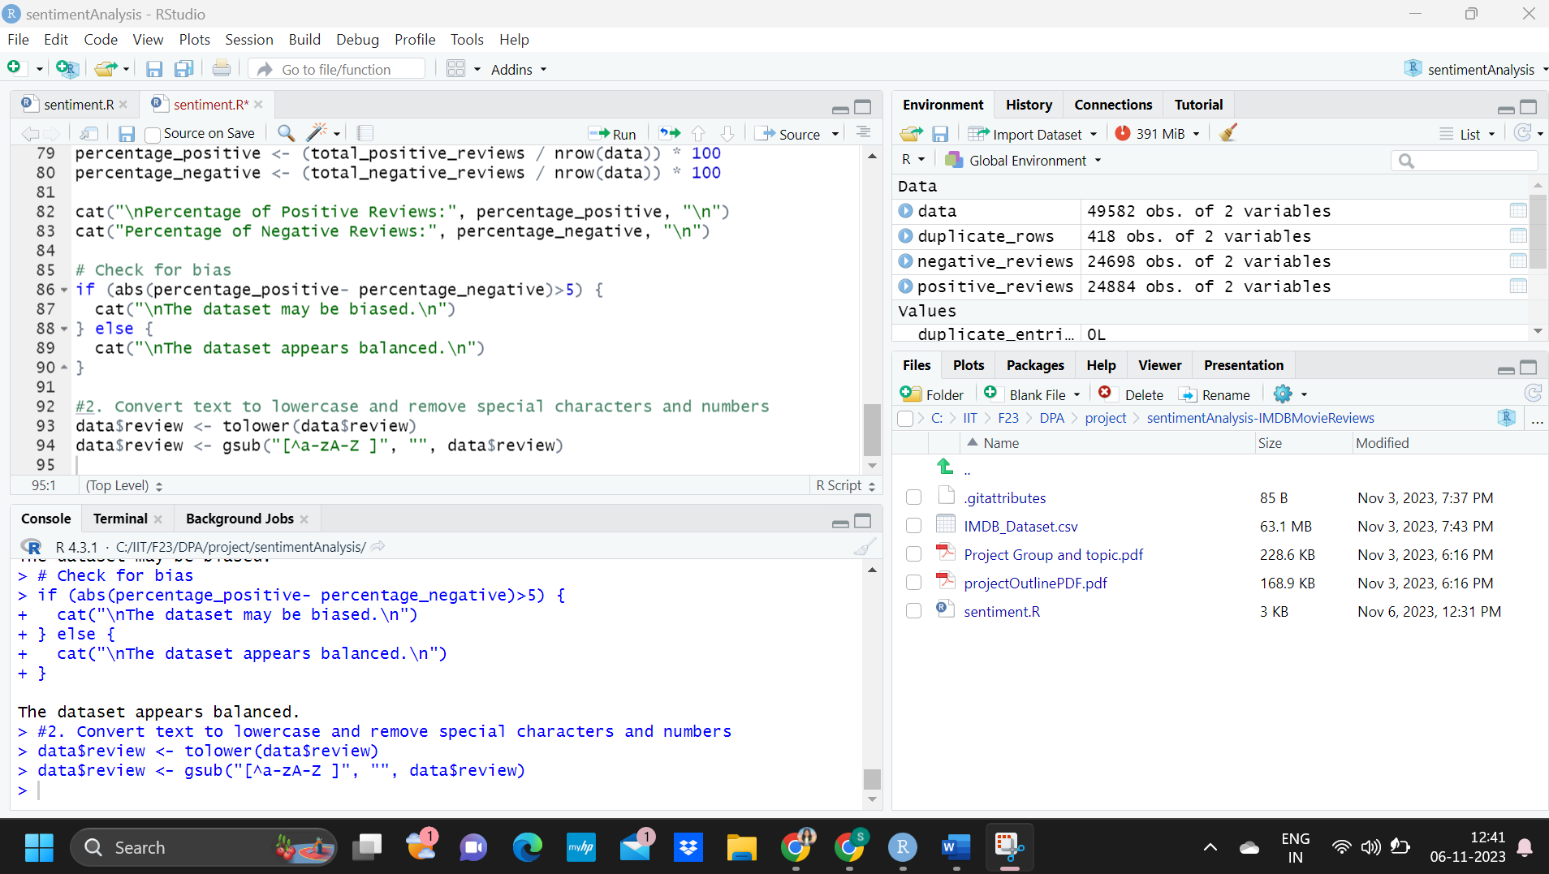
HANDLING MISSING/DUPLICATE ENTRIES

Slide 13
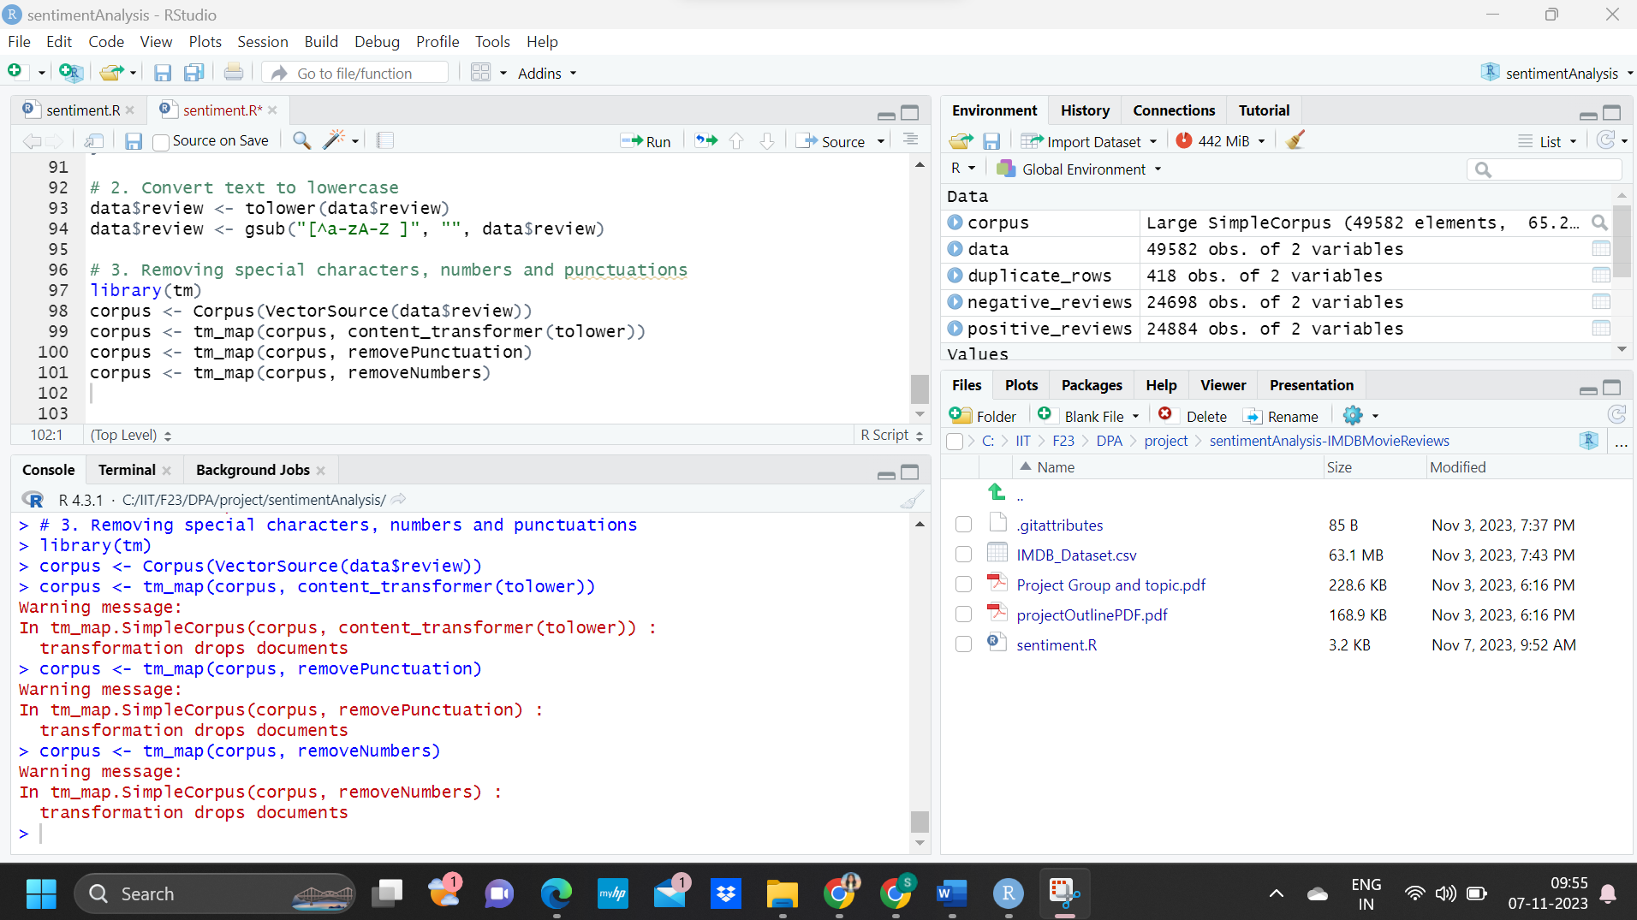
CLASS DISTRIBUTION
CONVERTING TEXT TO LOWER CASE

Slide 14
CLASS DISTRIBUTION
REMOVING SPECIAL CHARACTERS, NUMBERS, PUNCTUATIONS

Slide 15
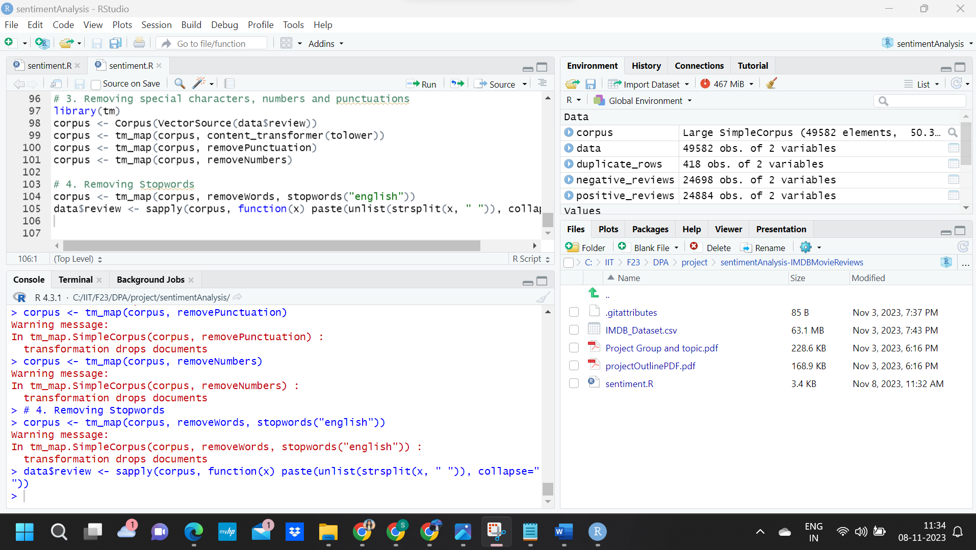
REMOVING STOPWORDS

Slide 16
Data Exploration/ Visualization
Distribution of sentiment labels
Identify frequent words in positive reviews
Impact of review length on sentiment classification
Linguistic & Textual patterns differentiating Positive and Negative

Slide 17
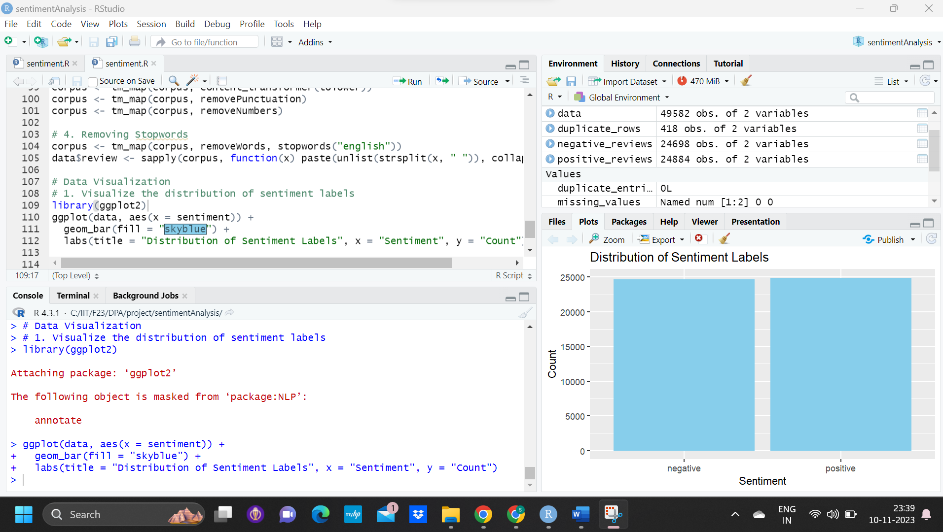
DISTRIBUTION OF SENTIMENT LABLES
DISTRIBUTION OF SENTIMENT LABELS
The plot illustrates the distribution of sentiment labels in a dataset. Two bars, each representing the count of reviews classified into two categories: "negative" and "positive". The heights of the bars appear to be almost identical, suggesting that the dataset is relatively balanced in terms of sentiment distribution.

Slide 18
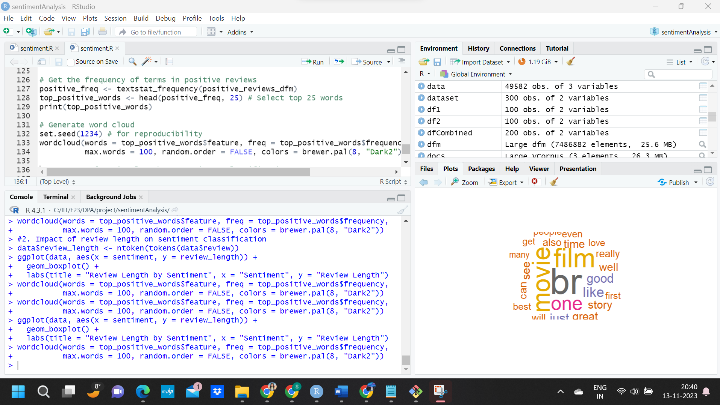
IDENTIFY FREQUENT WORDS IN POSITIVE REVIEW
The most prominent words are "movie", "film", "one", and "story", which suggests these terms are frequently used in the dataset from which the word cloud was generated. Other notable words include "good", "great", "best", "love", and "like", which might indicate positive sentiment in the reviews. The presence of words like "time", "see", "well", and "really" could be part of common phrases used in movie critiques or recommendations.

Slide 19
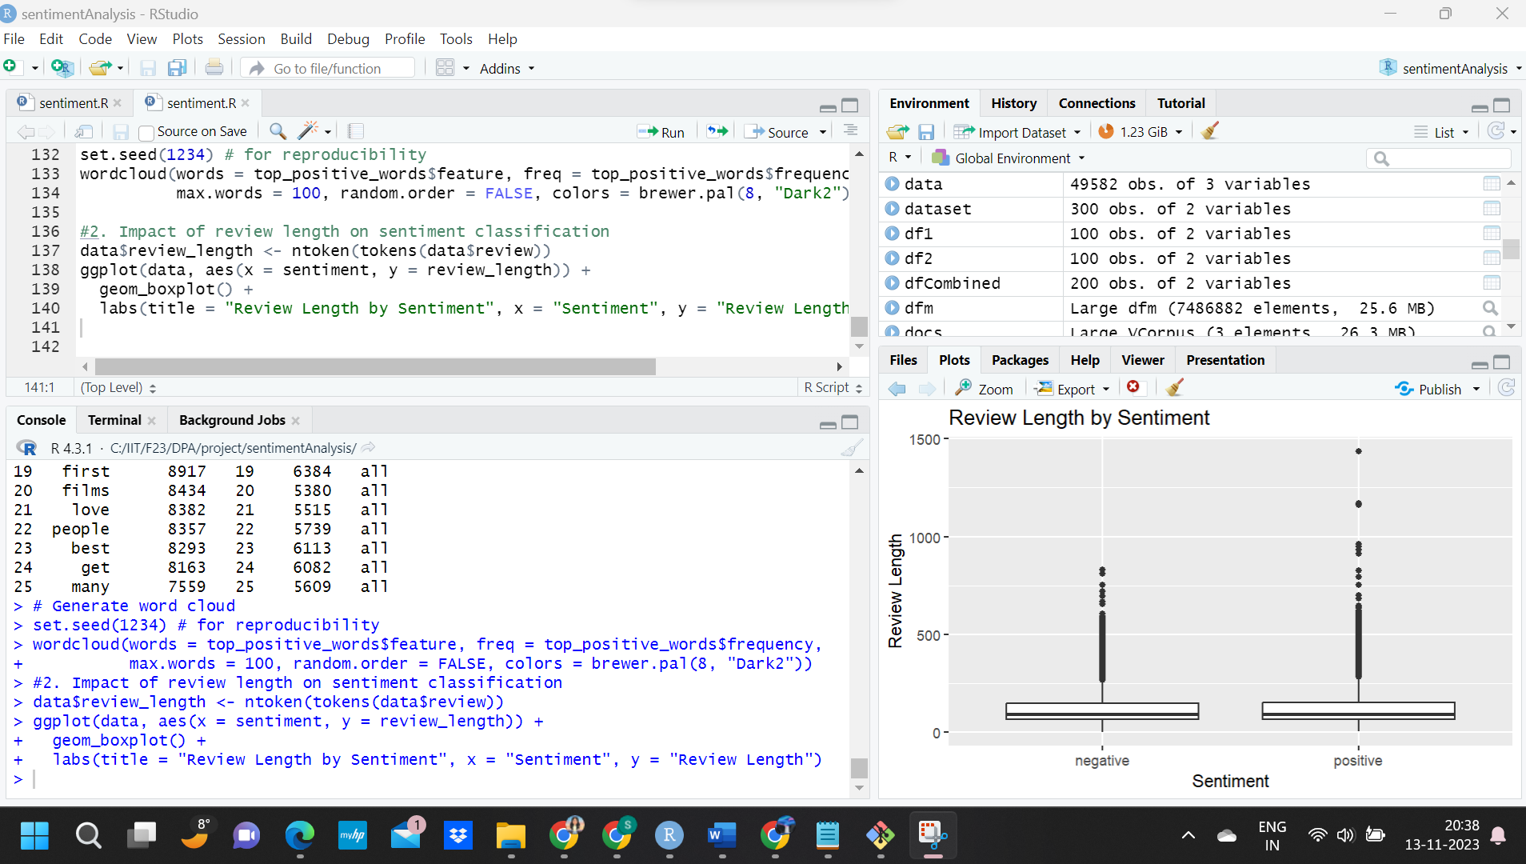
REVIEW LENGTH BY SENTIMENT
IMPACT OF REVIEW LENGTH
Both negative and positive reviews have a similar range of lengths, with the medians also appearing quite similar. This suggests that the sentiment of a review does not necessarily correlate with its length.

Slide 20
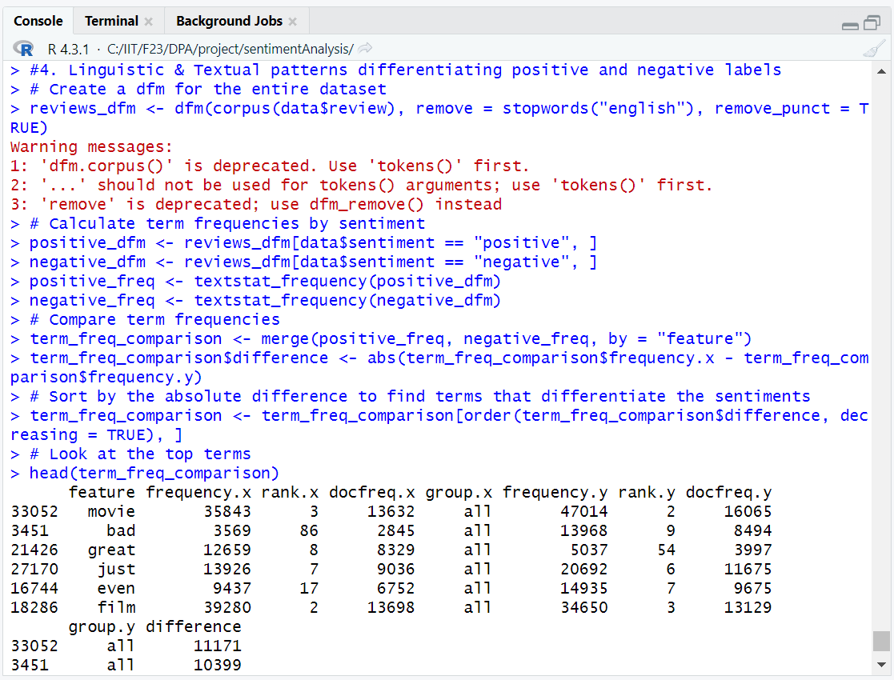
LINGUISTIC AND TEXTUAL PATTERNS DIFFERENTIATING POSITIVE AND NEGATIVE REVIEWS

Slide 21
Building model
Split train and test data
Create document feature matrix
Train Naïve Bayes classifier, Logistic reg, SVM

Slide 22
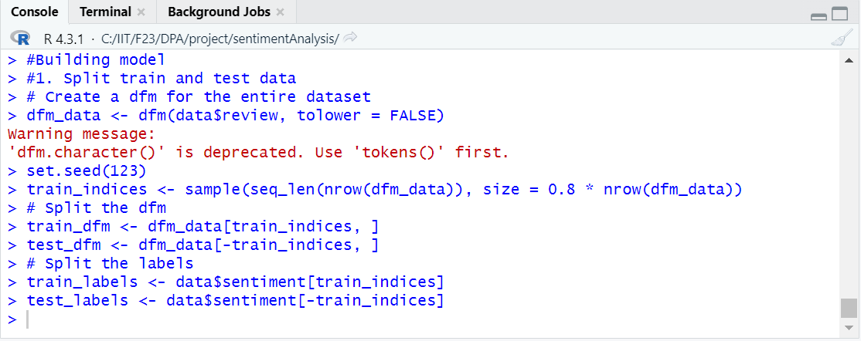
SPLIT TRAIN AND TEST DATA & CREATE DFM

Slide 23
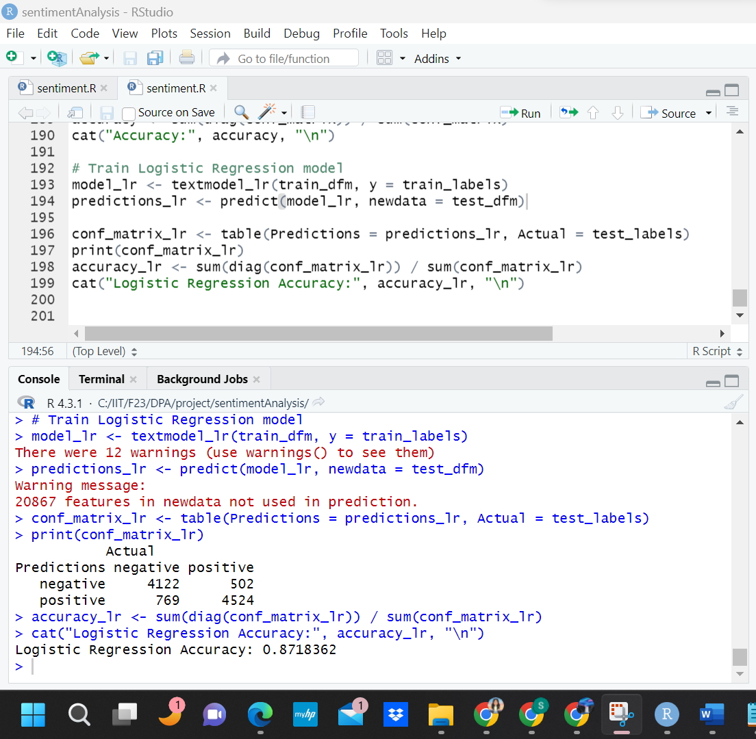
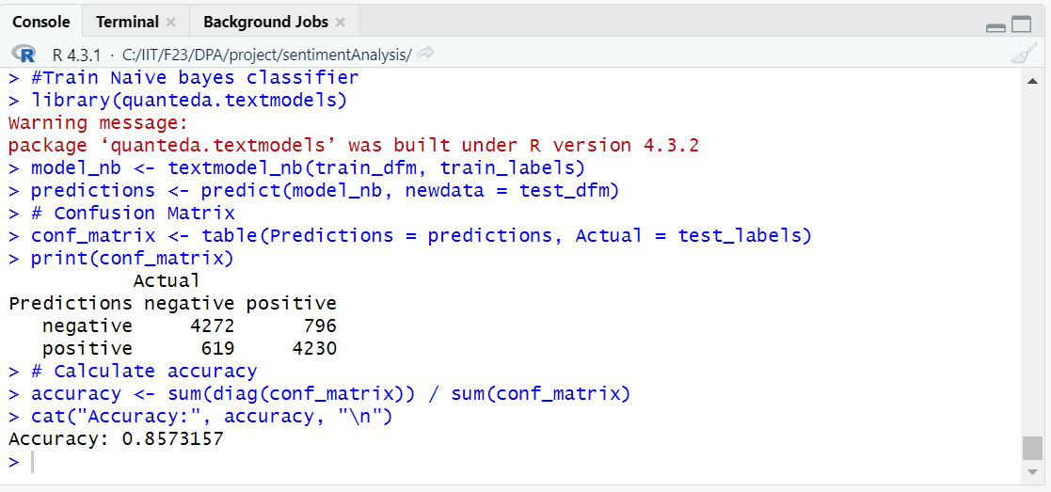
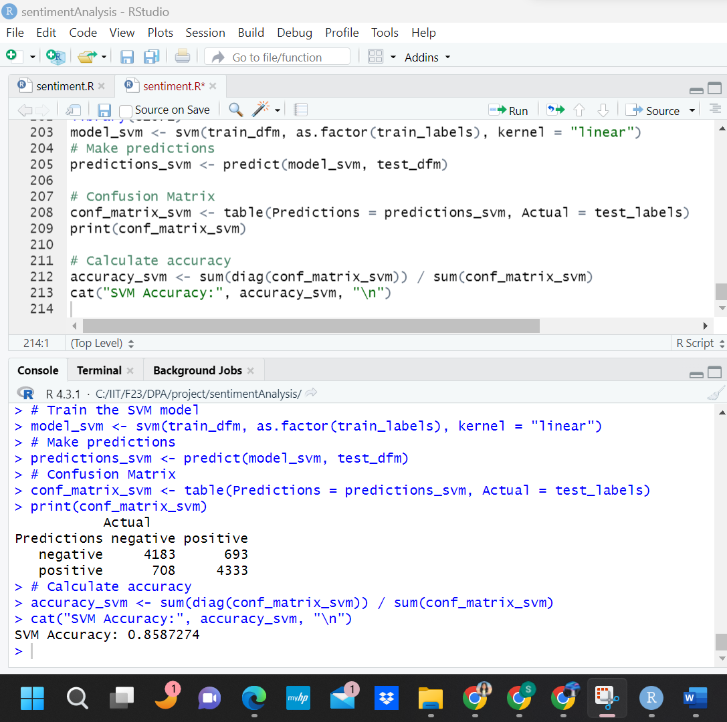
PREDICTIONS AND ACCURACY
TRAIN MODEL USING NAÏVE BAYES, LOGISTIC REGRESSION AND SVM

Slide 24
EVALUATING MODEL
Confusion matrix and accuracy metric
ROC curve and AUC

Slide 25
LOGISTIC REGRESSION ACCURACY
CONFUSION MATRIX AND ACCURACY METRIC
Naïve bayes model
Logistic regression model
Support vector machine model
Logistic regression gave higher accuracy of 87.18%!

Slide 26
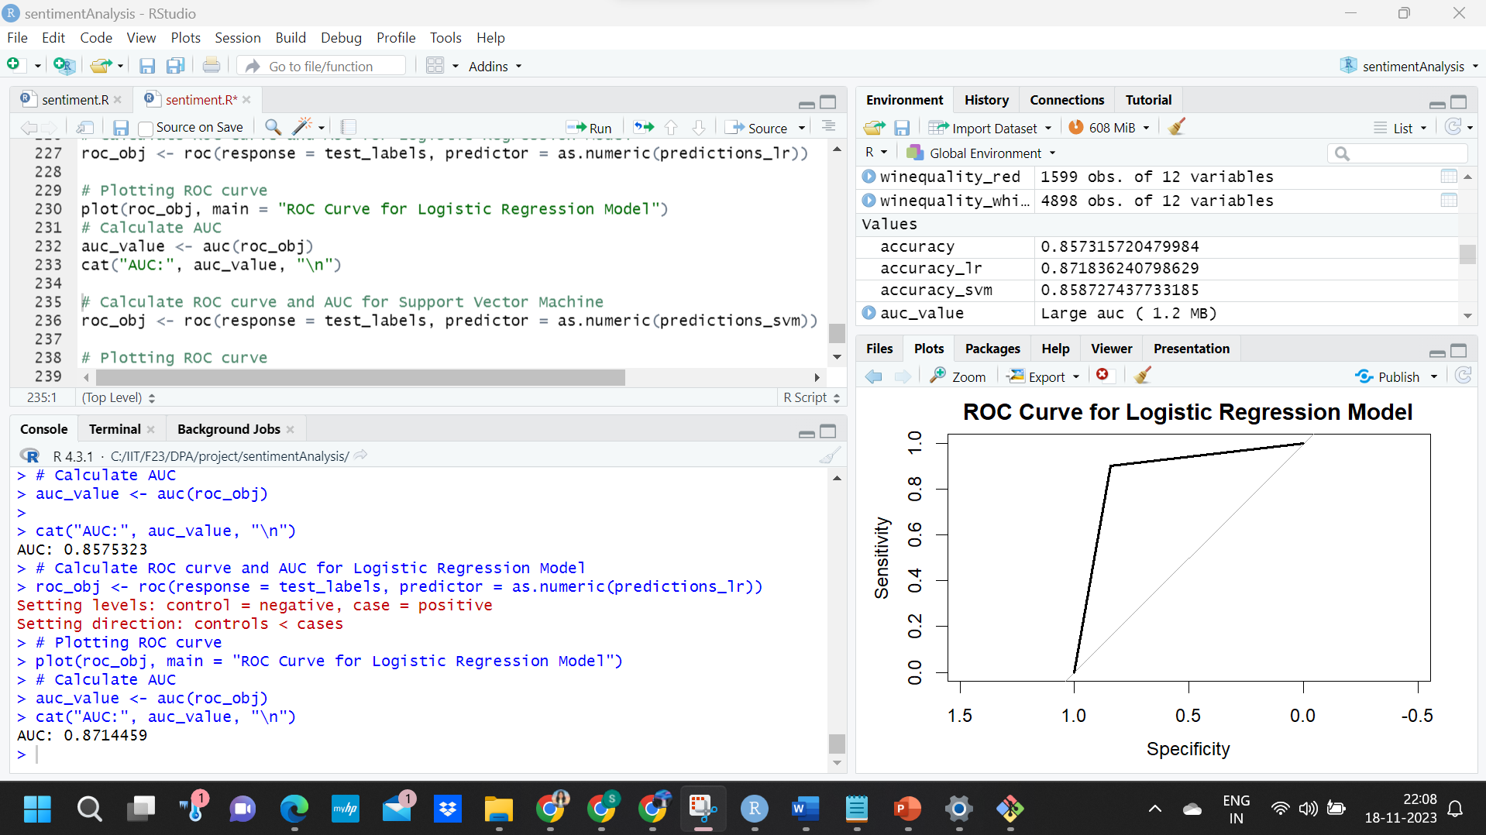
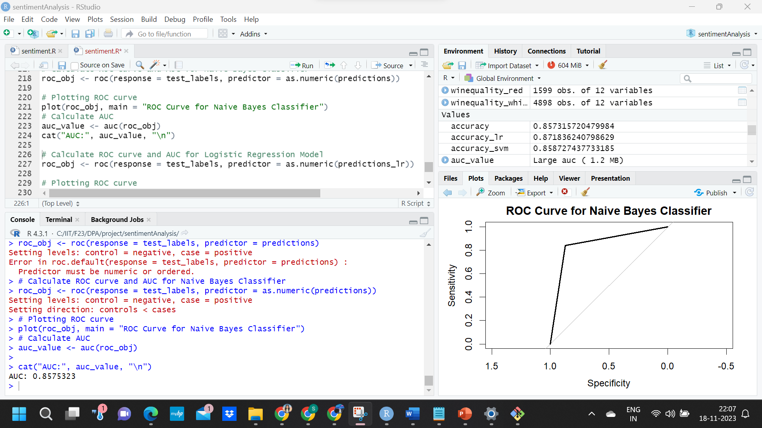
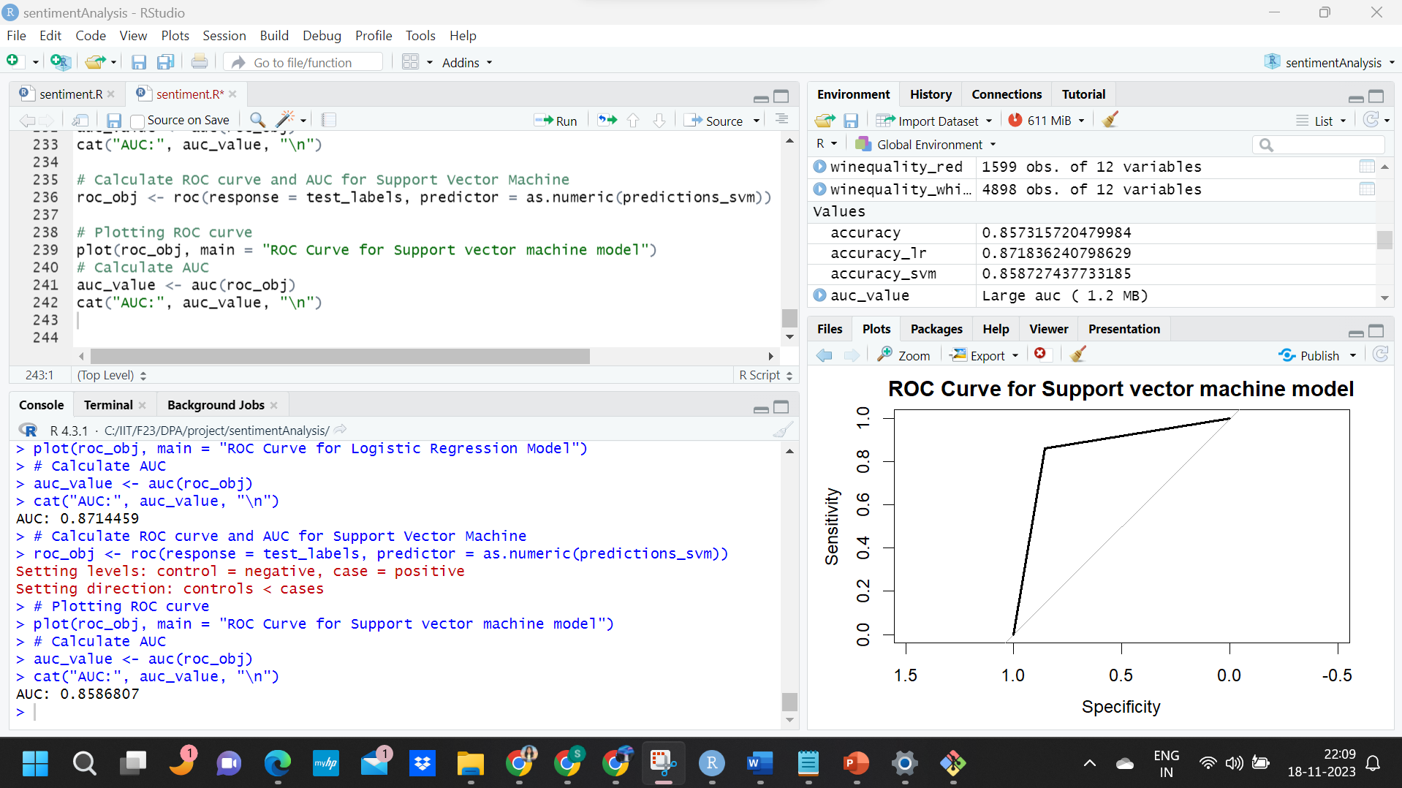
PREDICTION AND SVM ACCURACY
ROC CURVE AND AUC
All three curves are intended to show the effectiveness of the respective models in classifying the sentiment of the reviews.

Slide 27
PREDICTION AND SVM ACCURACY
ROC CURVE AND AUC
The AUC is calculated for each model's ROC curve, providing a single metric to assess the model's discriminatory power.
The Area Under the Curve (AUC) for the Logistic Regression model is higher compared to the Naive Bayes and Support Vector Machine (SVM) models, this indicates that the Logistic Regression model has a better overall performance in terms of distinguishing between the positive and negative classes for this particular sentiment analysis task.

Slide 28
Deploying model
Defining API script
Add sentiment probabilities to API script
Start API server
Sending POST requests to make predictions

Slide 29
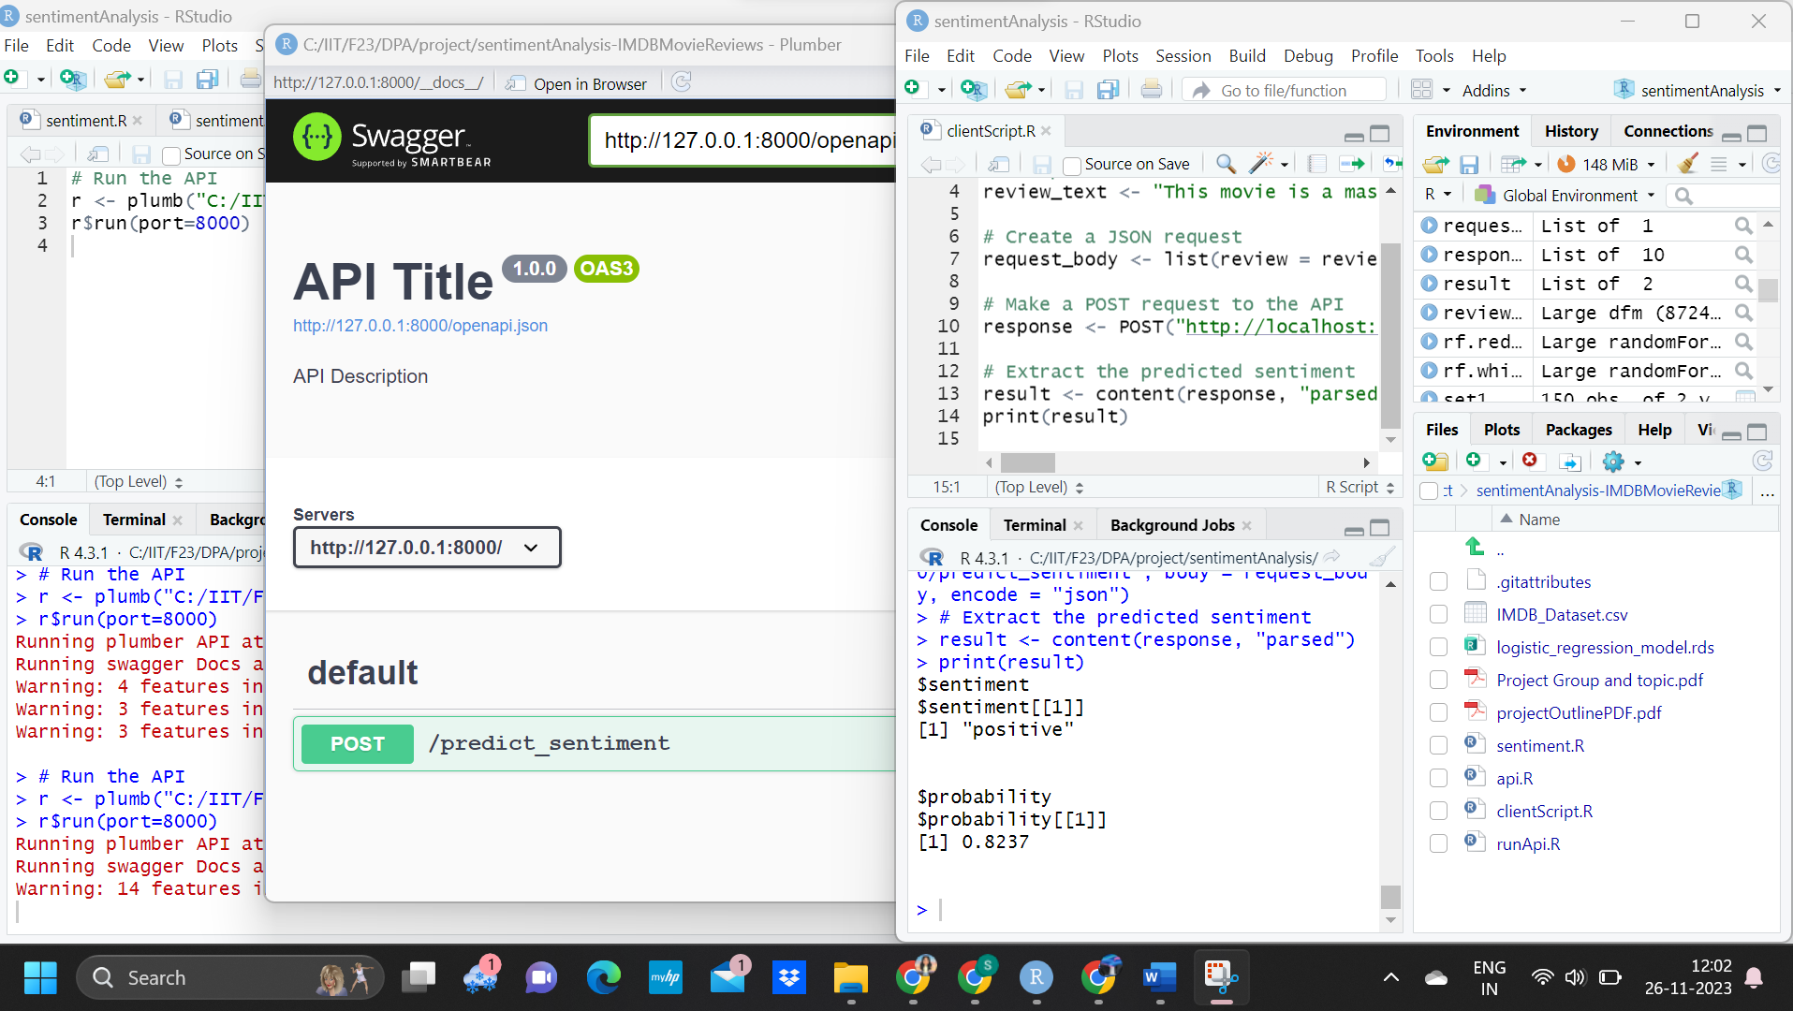

Slide 30
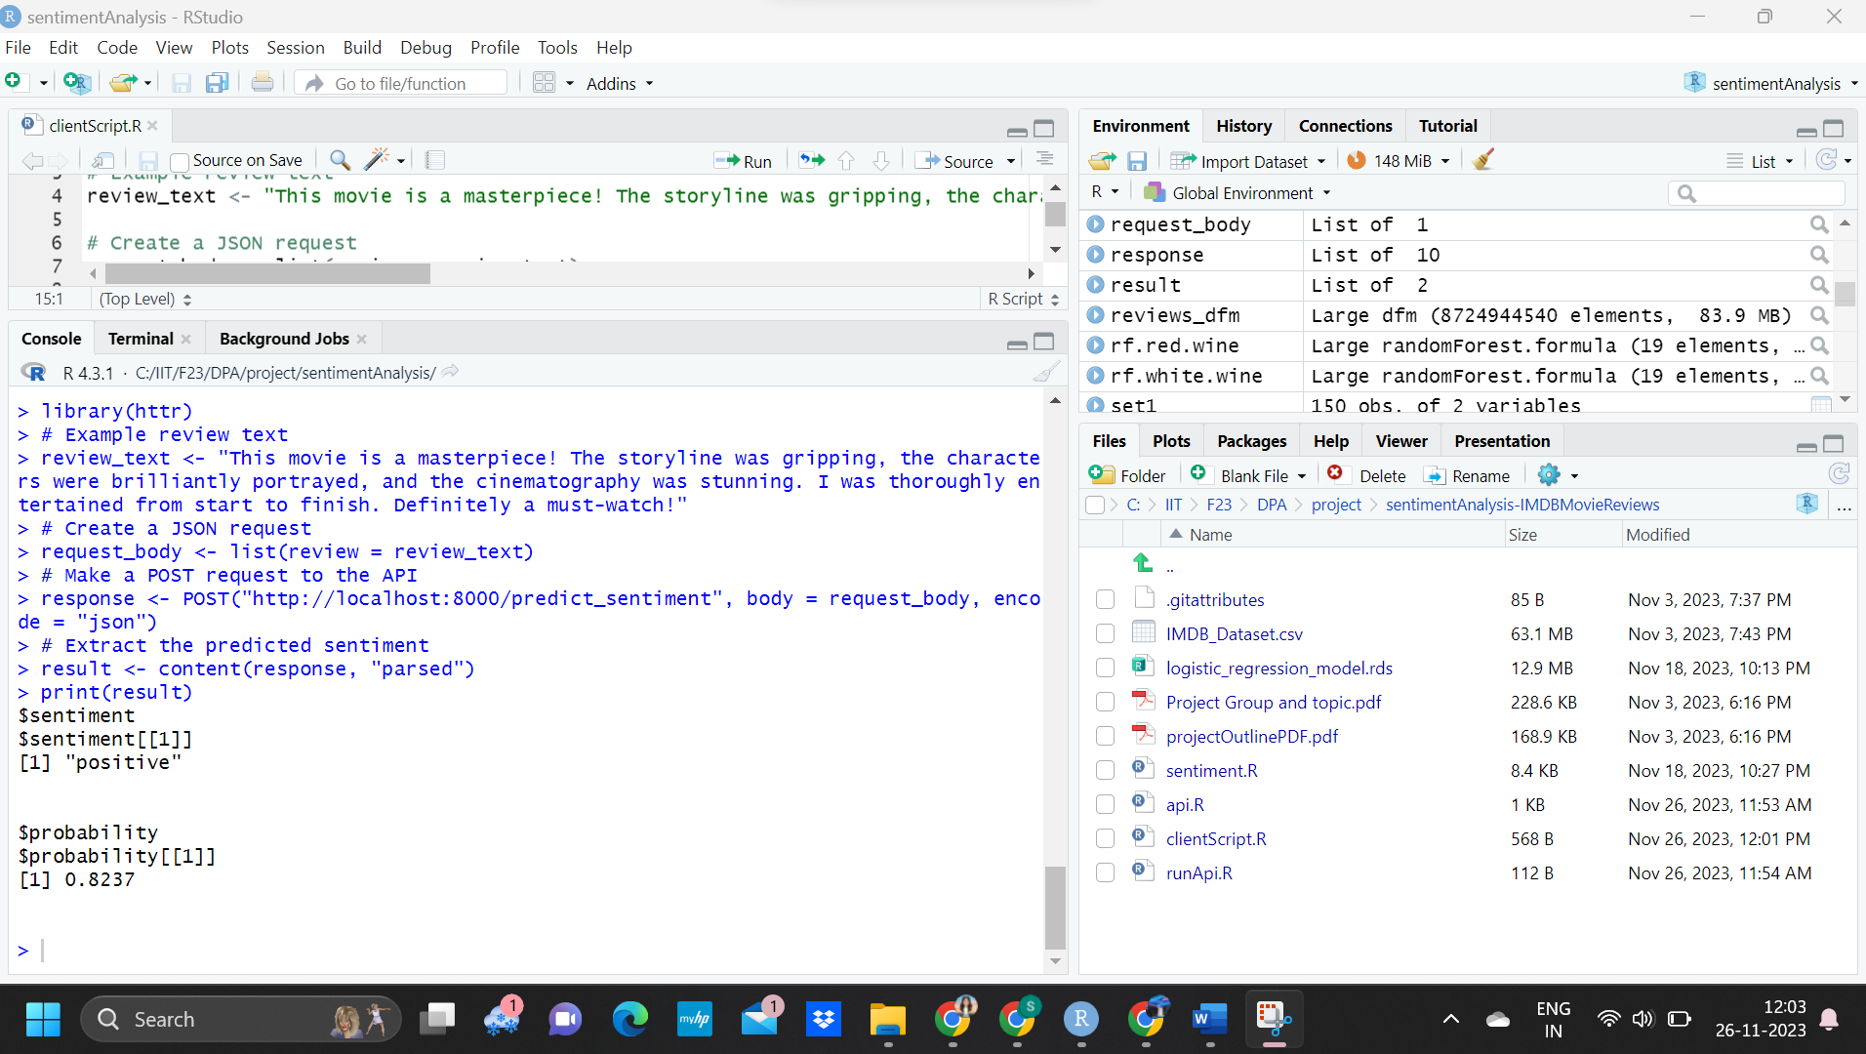
The review: “This movie is a masterpiece! The storyline was gripping, the characters were brilliantly portrayed, and the cinematography was stunning. I was thoroughly entertained from the start to finish. Definitely a must-watch!”, is classified into “positive” with 82.37% probability.

Slide 31
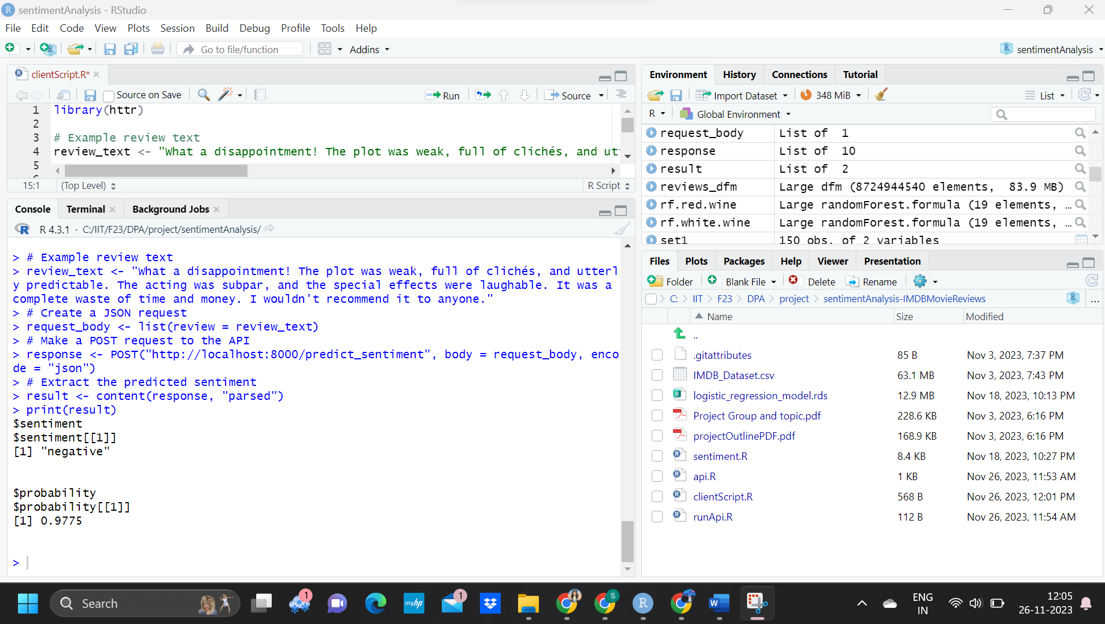
EXAMPLE OF AN SENTIMENT NEGATIVE
The review : "What a disappointment! The plot was weak, full of clichés, and utterly predictable. The acting was subpar, and the special effects were laughable. It was a complete waste of time and money. I wouldn't recommend it to anyone.“,
is classified as “negative” with 97.75% probability.

Slide 32
CONCLUSION
The sentiment analysis project achieved its primary objective of developing a robust and efficient tool capable of classifying movie reviews into 'positive' or 'negative' sentiments
This was accomplished through meticulous data preprocessing, which included normalization, cleansing, and feature extraction from the textual data. The use of advanced NLP techniques and machine learning models
Through rigorous model evaluation, including accuracy metrics, confusion matrices, ROC curves, and AUC values, the Logistic Regression model emerged as the most effective, striking a balance between accuracy and computational efficiency with 87.18% accuracy. This model was subsequently encapsulated into an API, showcasing the project's full-cycle capability from data analysis to real-world application.

Slide 33
REFERENCES
[1] Pang, B., & Lee, L. (2008). Opinion mining and sentiment analysis. *Foundations and Trends® in Information Retrieval, 2*(1–2), 1-135.
[2] Kuhn, M., & Johnson, K. (2013). Applied Predictive Modeling. Springer.
[3] Wickham, H., & Grolemund, G. (2016). R for Data Science: Import, Tidy, Transform, Visualize, and Model Data. O'Reilly Media.
[4] Manning, C. D., Raghavan, P., & Schütze, H. (2008). Introduction to Information Retrieval. Cambridge University Press.
[5] Quinlan, J. R. (1993). C4.5: Programs for Machine Learning. Morgan Kaufmann.
[6] James, G., Witten, D., Hastie, T., & Tibshirani, R. (2013). An Introduction to Statistical Learning: with Applications in R. Springer.
[7] Yu, Hong, et al. "Improved movie review sentiment classification using sentence-level lexicon polari." Expert Systems with Applications 36.2 (2009)
[8] Joshi, Mahesh, et al. "Movie reviews and revenues: An experiment in text regression." Proceedings of the 5th international conference on Weblogs and Social Media. 2011.
[9] Pak, A., & Paroubek, P. (2010). Twitter as a Corpus for Sentiment Analysis and Opinion Mining.

Slide 34
THANK YOU

